Slide 1
AI Tools for Productivity and Workflow Automation
(أدوات الذكاء الاصطناعي للإنتاجية وأتمتة سير العمل)

Slide 2
Outline
Workflow Automation Platform (منصة أتمتة سير العمل)
Smart Scheduling Assistant (مساعد جدولة ذكي)
AI Meeting Assistant (مساعد اجتماعات بالذكاء الاصطناعي)
AI Productivity Assistant (مساعد إنتاجية بالذكاء الاصطناعي)
AI Checklist Creator (منشئ قوائم مهام بالذكاء الاصطناعي)
AI Accountability Assistant (مساعد المتابعة والمساءلة بالذكاء الاصطناعي)
Streamlined Customer Support(صياغة البريد الإلكتروني بواسطة الصوت)
AI-Enhanced Collaboration (تعاون معزز بالذكاء الاصطناعي)
AI Web Crawler (زاحف ويب بالذكاء الاصطناعي)
AI Web Scrapers (أدوات استخراج بيانات الويب بالذكاء الاصطناعي)

Slide 3





Unlocking Efficiency with AI
Artificial Intelligence is revolutionizing how we work, offering powerful tools to streamline tasks, boost productivity, and extract valuable insights from data. This presentation explores a curated selection of AI solutions designed to transform your academic and professional workflows.
Automation
Automate repetitive tasks.
Productivity
Enhance personal and team output.
Meetings
Optimize collaboration and capture insights.
Marketing
Refine campaigns and content creation.
Data Extraction
Efficiently gather and process information.

Slide 4


n8n: Workflow Automation Platform
n8n is a free and open-source workflow automation tool that helps you connect apps and automate tasks without coding. It allows for complex custom workflows across hundreds of services.
Website: n8n.io
Steps to Use:
Choose your trigger application (e.g., new email).
Define subsequent actions (e.g., add to spreadsheet, send notification).
Map data between applications.
Activate your workflow to run automatically.
Practical Example:
Automate lead capture from a web form directly into a CRM and send a welcome email.

Slide 5


Reclaim AI: Smart Scheduling Assistant
Reclaim AI intelligently schedules your tasks, habits, and meetings, finding the best time blocks in your calendar. It optimizes your day to maximize productivity and minimize scheduling conflicts.
Website: reclaim.ai
Steps to Use:
Connect your calendar (Google or Outlook).
Input tasks and habits with priority and duration.
Let Reclaim AI find the optimal slots.
Protect your focus time and adapt to changes.
Practical Example:
Automatically block time for "deep work" each morning and reschedule if meetings arise.

Slide 6




Fireflies.ai: AI Meeting Assistant
Fireflies.ai is an AI assistant that records, transcribes, and summarizes your meetings. It integrates with major conferencing platforms to ensure no detail is missed, making meetings more productive.
Record
Transcribe
Summarize
Captures audio from virtual meetings.
Converts speech to text accurately.
Generates concise meeting summaries.
Website: fireflies.ai
Steps to Use:
Connect to your calendar or conferencing tool.
Invite Fireflies.ai to your meeting.
Receive transcripts and summaries post-meeting.
Search for key information within conversations.
Practical Example:
Automatically generate action items and decisions from team meetings and share with attendees.

Slide 7

Success AI: AI Productivity Assistant
Success AI provides a suite of tools for sales and marketing automation, including email outreach, lead generation, and CRM integration. It uses AI to personalize communication and optimize campaign performance.
Personalized Outreach
Lead Generation
CRM Integration
Craft AI-driven emails for higher engagement.
Identify and qualify potential customers efficiently.
Seamlessly connect with existing sales systems.
Website: success.ai
Steps to Use:
Define your target audience and campaign goals.
Utilize AI to draft compelling email sequences.
Monitor campaign performance and A/B test.
Integrate insights into your sales pipeline.
Practical Example:
Create a personalized email marketing campaign for a new product launch based on customer segments.

Slide 8


Checklist Genie: AI Checklist Creator
Checklist Genie transforms chaotic to-do lists into smart, AI-powered workflows. It helps organize complex projects, assign tasks, and track progress, ensuring nothing falls through the cracks.
Website: checklistgenie.ai
Steps to Use:
Input project tasks and deadlines.
Genie AI suggests optimal task breakdowns.
Assign tasks to team members.
Track progress with intuitive dashboards.
Practical Example:
Manage a research paper submission process, from outline creation to final proofreading, with smart checklists.

Slide 9



Commitify: AI Accountability Assistan
Commitify leverages AI to analyze code changes and generate clear, concise commit messages. It promotes better code documentation, improves team collaboration, and streamlines the development workflow.
Code Analysis
Message Generation
Team Collaboration
Intelligently interprets code changes.
Crafts descriptive commit messages.
Ensures consistent and clear communication.
Website: commitify.ai
Steps to Use:
Integrate with your version control system (e.g., Git).
Stage your code changes.
Commitify AI suggests a message.
Review and approve the generated commit.
Practical Example:
Automatically generate clear commit messages for a complex feature implementation, detailing changes and purpose.

Slide 10



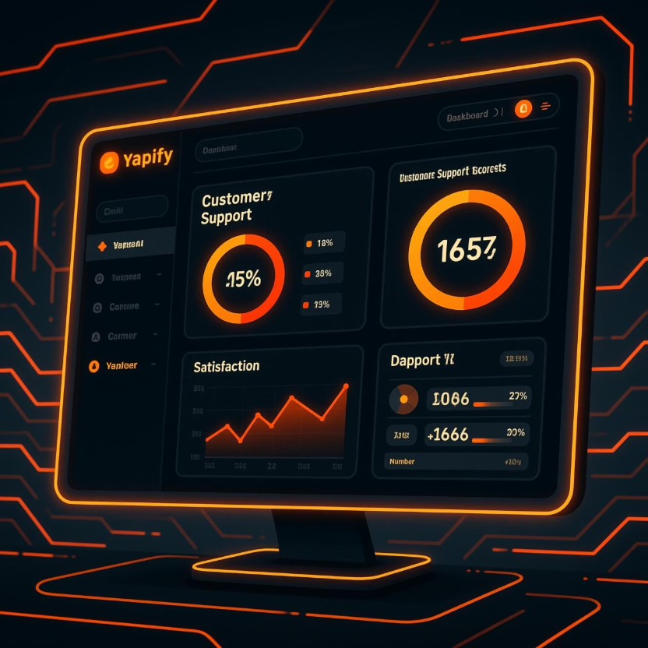
Yapify: Streamlined Customer Support
Yapify uses AI to enhance customer support by automating responses, analyzing sentiment, and routing inquiries. It helps businesses provide faster, more efficient, and personalized support experiences.
Automated Responses
Sentiment Analysis
Smart Routing
AI-driven replies to common queries.
Understand customer mood and prioritize.
Direct inquiries to the right agents.
Website: yapify.ai
Steps to Use:
Integrate with your support channels.
Train the AI with your knowledge base.
Define automation rules and escalation paths.
Monitor performance and refine AI responses.
Practical Example:
Deploy an AI chatbot on your website to answer FAQs and escalate complex issues to human agents.

Slide 11


Firecrawl: AI Web Crawler
Firecrawl provides powerful web scraping capabilities, allowing you to extract structured data from any website efficiently. It's ideal for data aggregation, content monitoring, and research.
Website: firecrawl.dev
Steps to Use:
Specify the target URL or domain.
Define the data points you want to extract.
Run the crawler and retrieve structured data.
Integrate extracted data into your applications.
Practical Example:
Gather product information and pricing from competitor websites for market analysis.

Slide 12


Miro: AI-Enhanced Collaboration
Miro is an online collaborative whiteboard platform designed for distributed teams to brainstorm, plan, and create together. It offers an infinite canvas for visual thinking, project management, and creative workshops.
Website: miro.com
Steps to Use:
Choose a template or start with a blank board.
Invite team members to collaborate in real-time.
Utilize tools like sticky notes, shapes, diagrams, and comments.
Facilitate workshops, meetings, or project planning sessions.
Export boards or integrate with other platforms.
Practical Example:
Design a new product user flow and gather real-time feedback from cross-functional teams on a shared Miro board.

Slide 13




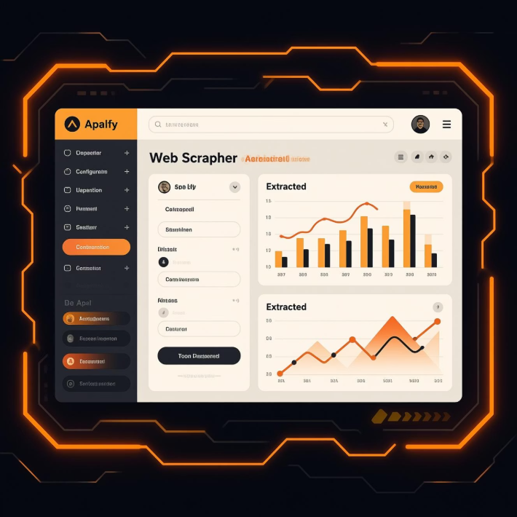
Apify: AI Web Scrapers
Apify is a cloud-based platform for web scraping and automation. It allows developers and businesses to extract data from websites, automate workflows, and integrate with various applications to streamline operations.
Scrape Any Website
Automate Workflows
Extract structured data from any public website with ease.
Build custom automation flows for repetitive web tasks.
Scale Data Operations
Run hundreds of scrapers and automations concurrently.
Website: apify.com
Steps to Use:
Define your scraping or automation task.
Choose a pre-built actor or build a custom one.
Configure input parameters and target URLs.
Run the task and retrieve your extracted data.
Integrate with APIs or export to various formats.
Practical Example:
Monitor competitor pricing daily by scraping product pages and setting up alerts for changes.

